Slide 1
API Requests and Responses
SEI

Slide 2
Fetching Data
SEI

Slide 3
APIs Sound Great! How Do I Get Started?
APIs work on a request-response cycle, so our first step is to make a request. API requests use the HTTP protocol, meaning we’ll need to use a URL address.
Port
Query
http://www.domain.com:1234/path/to/resource?a=b&x=y
Protocol
Host
Resource path

Slide 4
Asynchronous Code With Async/Await
API calls are asynchronous code. Because we have no idea how long the response will take to return, we have to await the result. We can do so using two keywords that come as a pair: async and await.
async function askForData(){
const response = await fetch(url);
const data = await response.json();
}
Notes:
TEACHING TIPS:
Feel free to get as involved with the behind-the-scenes workings as possible, such as showing alternative versions of handling promises in JS. However, this is historically the cleanest and clearest way of getting the job done.

Slide 5

Fetching Data With fetch()
Once you have an address, you can send a request using JavaScript’s built-in fetch() method, which accepts the destination URL as a parameter and returns a promise.
Promises are a proxy for a value that has not returned yet… but is on its way! This code is asynchronous, so we use async & await.
const response = await fetch(url);

Slide 6
Evaluating APIs
SEI

Slide 7
Read the Docs!
Every API is unique — you will have to explore its documentation to figure out what data you want to access and what URL to use in order to send requests. However, there are a few standard details to check for in any API:
Do I need an API key?
If so, are there rate limits or charges for requests?
How do I include the key in my requests?
What are the available endpoints for data?
What URL format can search for specific data?
What will the response data look like?
Typically the response will be JSON.

Slide 8
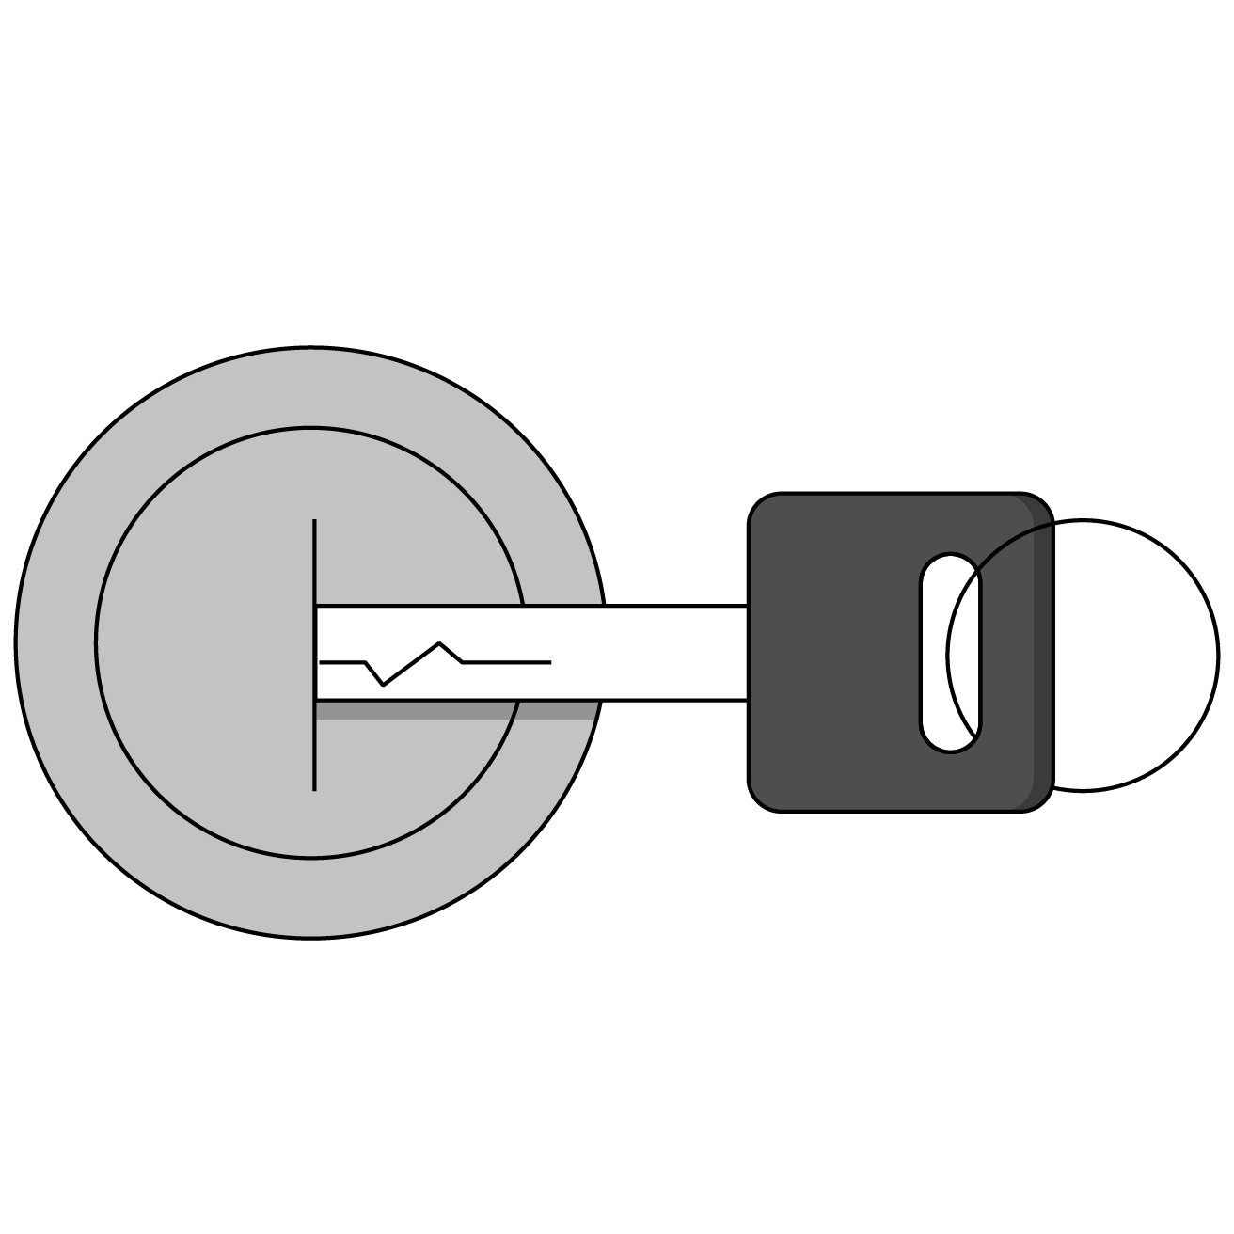
API Keys
Many APIs require you to include a key with your request.
You can register with the API’s website to receive your unique key.
Keys are used to track your requests for rate limits and potential charges. Don’t worry, most APIs have a free tier!

Slide 9

JS Objects
API endpoints will almost always return JSON in the form of an object.
{
“data”: “car”,
“make”: “ford”,
“model”: “focus”
“details”: {
“color” : “blue”,
“mileage” : “54019”
}
}

Slide 10
Many-Layered Objects
API response objects are infamously complex in their formats. To dig down to the layer of information you actually want, carefully log one layer at a time until you reach the data you’re looking for!
const carData = {
“data”: “car”,
“make”: “ford”,
“model”: “focus”
“details”: {
“color” : “blue”,
“mileage” : “54019”
}
};
console.log(carData);
console.log(carData.details);
console.log(carData.details.color);
Notes:
TEACHING TIPS:
You can also use the browser inspector for a convenient debugger-type object exploration environment.
It’s tough dealing with complex objects at first, so working one layer at a time is more testable and builds syntax skill.
You can log out the response object from the weather example to see how complex it can start as, and how commonly we need to chain properties to reach the goal.

Slide 11
Giphy Search
30 minutes
Where would the internet be without GIFs? Use the giphy.com API to create a GIF search application using your new API skills!
Notes:
TEACHING TIPS:
This should be tough but very fulfilling. Students may need to open up the console to see the large response object. Encourage them to read the documentation, test small pieces, and be resilient! You may need to guide them through it at key points.

Slide 12
Weather API
Let’s create a weather app together!
Notes:
TEACHING TIPS:
Refer back to this example throughout the steps of API usage in order to ground the concepts in a concrete scenario.

